Slide 1

Urban Air Quality Prediction
By
Bernard Djoko

Slide 2

"Did you know that poor air quality causes 7 million deaths worldwide each year?"
"Today, we’ll explore how machine learning models can predict air quality to prevent such outcomes."

Slide 3

Learning Objectives
By the end of this presentation, you will be able to:
Explain the factors influencing air quality CO(GT).
Understand how machine learning predicts air quality.
Compare the performance of different models.
Interpret model evaluation metrics such as MSE and R².

Slide 4

Pre-Assessment
Question:
"Which of the following factors affects air quality the most?“ Let’s focus on CO(GT) concentration of carbon monoxide in the air:
benzene (C6H6)
non-methane hydrocarbons PT08.S2(NMHC)
Nitrogen Oxides Nox(GT)

Slide 5
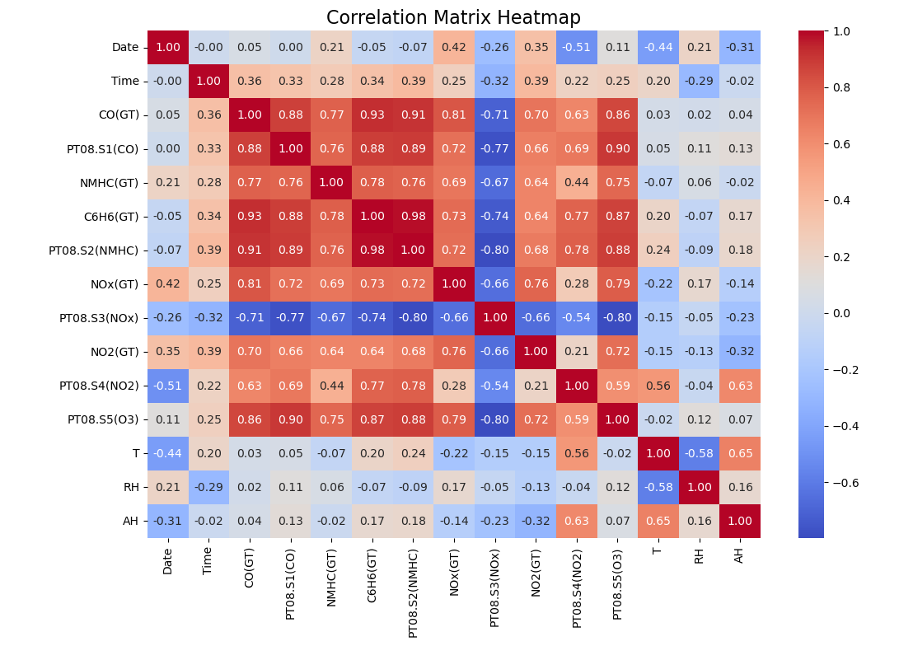
Air Quality Factors

Slide 6
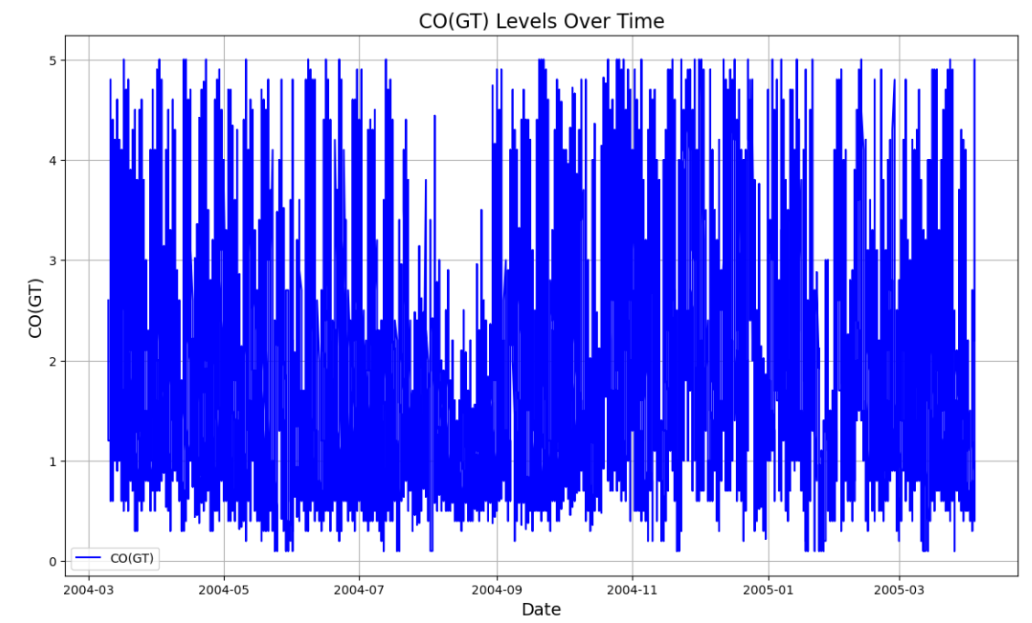
CO(GT) over time

Slide 7
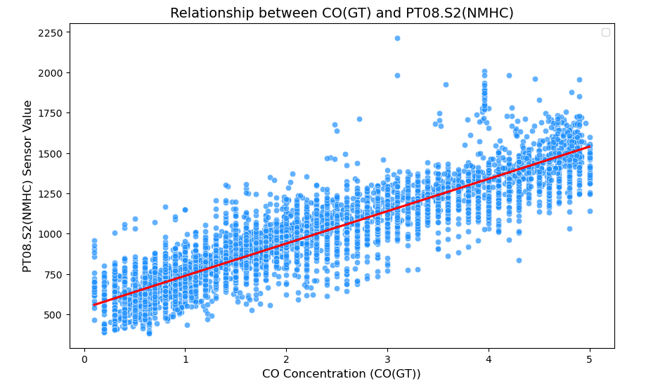
CO(GT) – PT08.S2(NMHC) Relationship

Slide 8
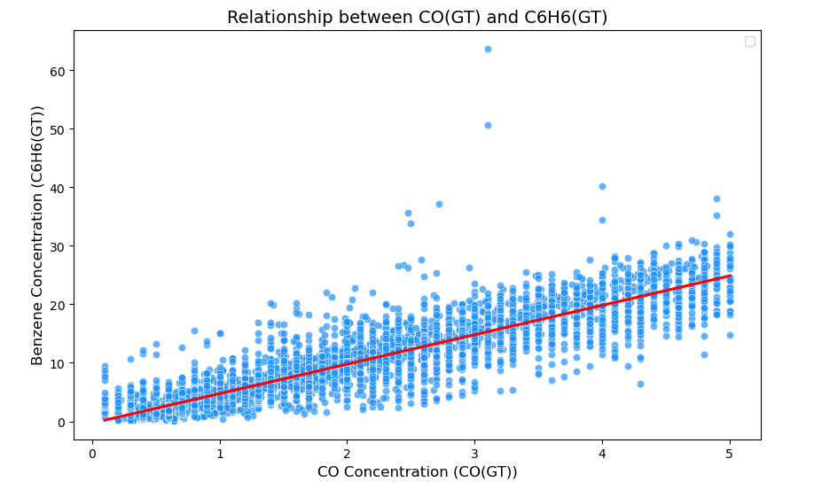
CO(GT) – PT08.S2(NMHC) Relationship

Slide 9
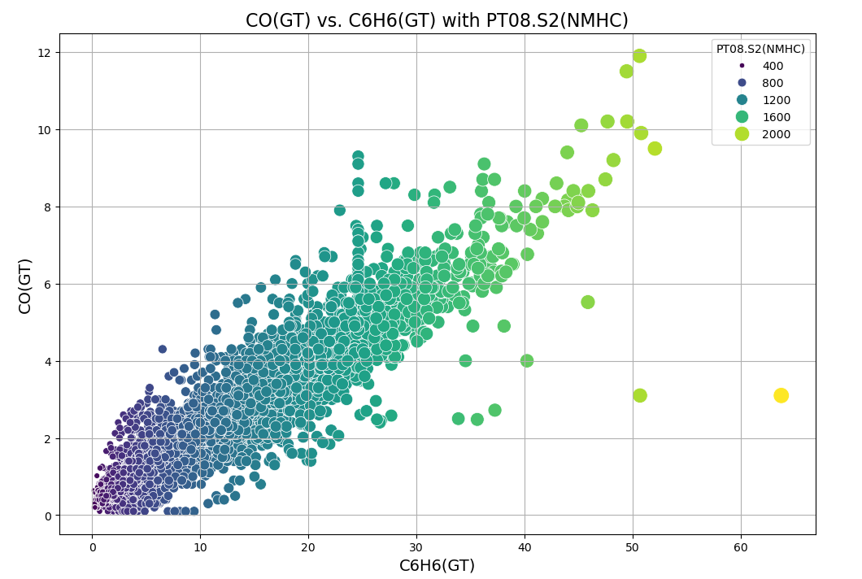
Multivariate Relationship

Slide 10
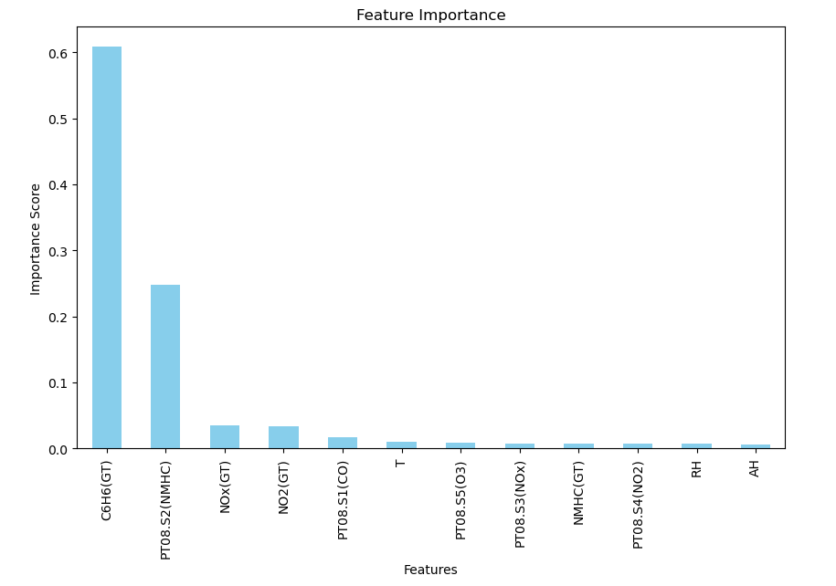
Features Importance

Slide 11
Model Introduction
Machine Learning Models
Decision Tree
K-Nearest Neighbors
Support Vector Machine
Random Forest

Slide 12
"Which model do you think performs best and why?"

Slide 13
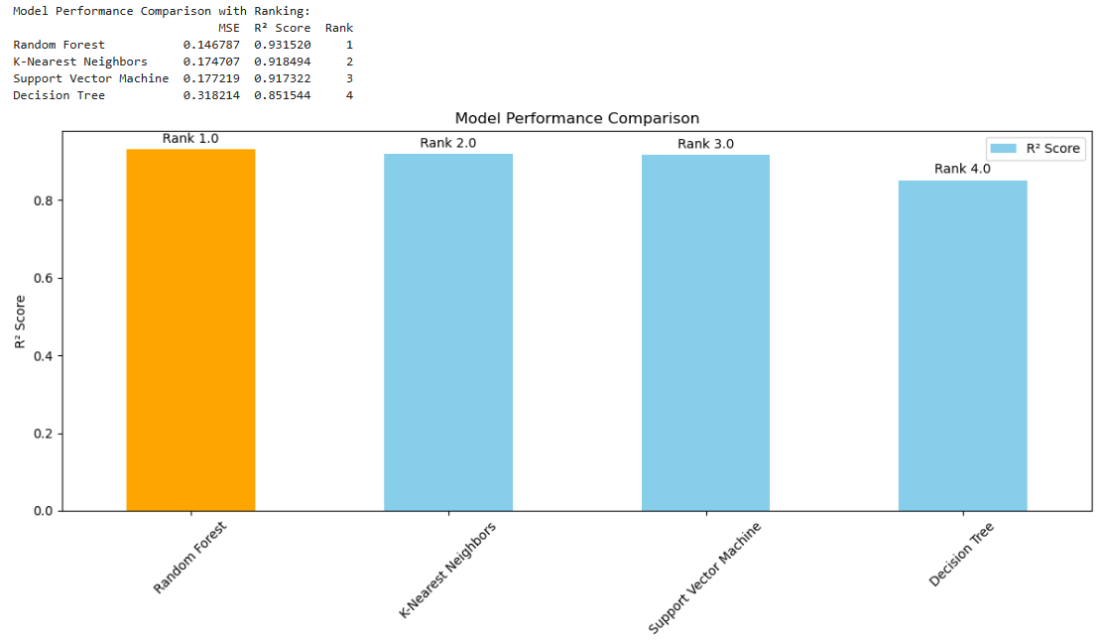
Model Evaluation - Accuracy/mean squared error

Slide 14
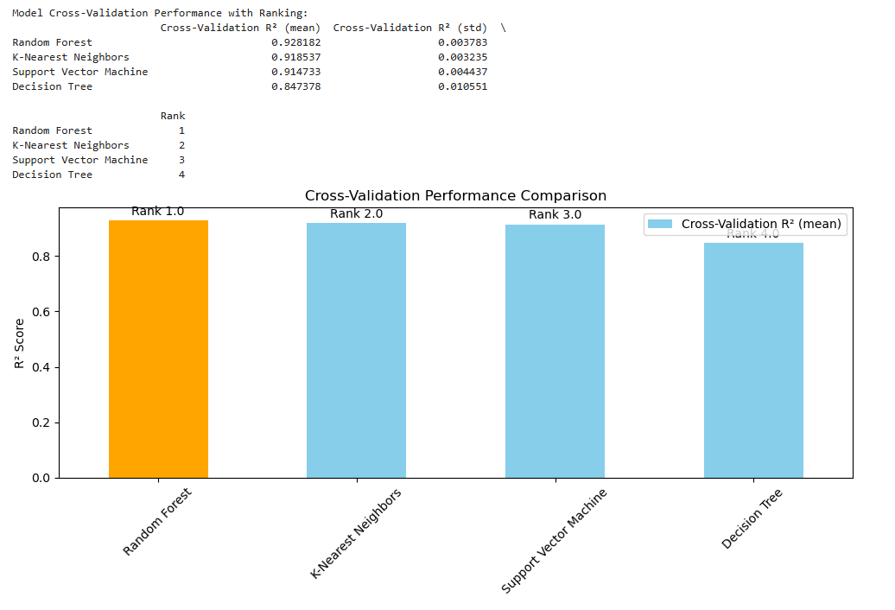
Model Evaluation – Cross Validation

Slide 15
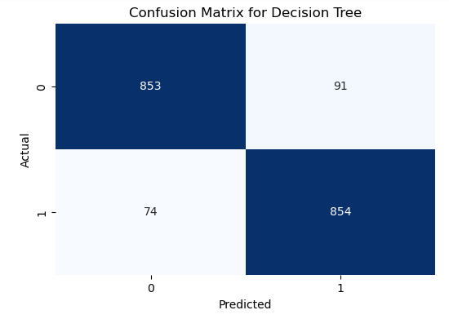
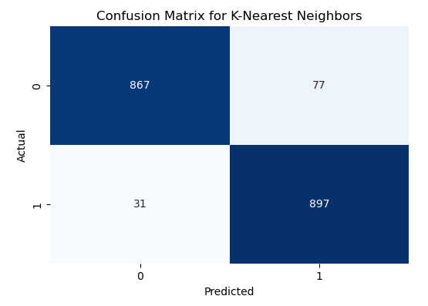
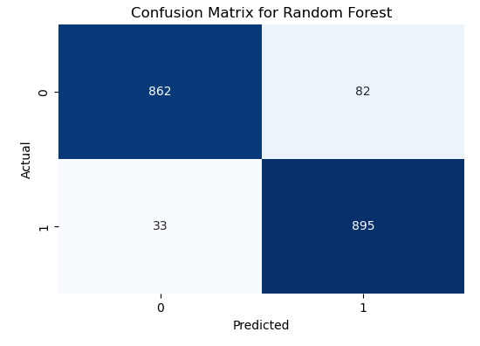
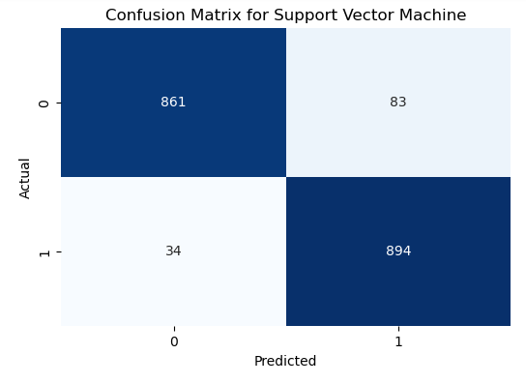
Model Evaluation – Confusion Matrix

Slide 16
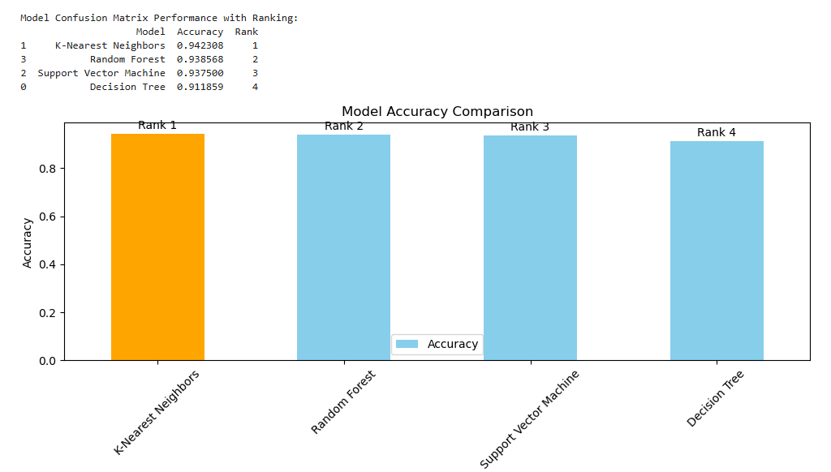
Model Evaluation – Confusion Matrix

Slide 17
Model Performance Summary
Model | Accuracy (Rank) | Cross-Validation R² (mean) (Rank) | MSE (Rank)
K-Nearest Neighbors | 0.9423(1) | 0.9185 (2) | 0.1747 (2)
Random Forest | 0.9386(2) | 0.9282 (1) | 0.1468 (1)
Support Vector Machine | 0.9375 (3) | 0.9147 (3) | 0.1772 (3)
Decision Tree | 0.9119 (4) | 0.8474 (4) | 0.3182 (4)
Random Forest is ranked 1st overall due to its high cross-validation R² and low MSE. It is also balancing both predictive accuracy and generalization performance, making it the best overall choice.

Slide 18
Recap
Key Pollutants: C6H6(GT) and PT08.S2(NMHC)
Models: Random Forest performed the best in this scenario

Slide 19
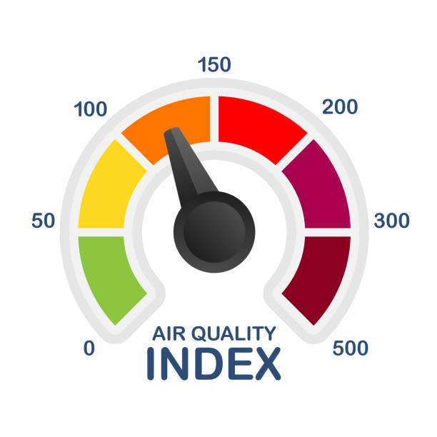
Thank You!

